Slide 1
GITAM University,Visakhapatnam Dept: CSE Project Phase – II Guide : Smt. Dr. Y. Radhika Project coordinator : Smt. Dr. R. Sireesha

Slide 2
ANALYSIS OF TWITTER TRENDS BASED ON SENTIMENT ANALYSIS AND GEOLOCATIONS
Anudeep Chaturvedula (1210312506)
Saurabh Rao(1210312512)
Mintu Matthew (1210312542)
Tarini Yenneti (1210312566)
B5 2012 – 2016

Slide 3
Abstract
Microblogging today has become a very popular tool for communication and voicing opinions among Internet users, where millions of users share opinions on varied topics. Microblogging platforms like Twitter allow users to share views within a 140 character limit, leading to a high rate of information compression. Users also have the option of adding images, links and videos among other things, which makes the type and variety of content very diverse. Here processing the tweet involves extraction of metadata of tweet, geocoding the physical address in a tweet, analysing the sentiment of content in the tweet text and extracting the significant and key phrases from a text.

Slide 4

Data mining – What is it ?
The practice of examining large pre-existing databases in order to generate new information.

Slide 5

Applications of Data Mining
Financial Data Analysis
Retail Industry
Telecommunication Industry
Biological Data Analysis
Other Scientific Applications
Intrusion Detection

Slide 6

Social Analytics – Why ?
Enables organizations to make smarter decisions
Determine factors that influence customer’s purchase decision
Converting data into into comprehensible and useful information
Strengthen brand identity
Effectively engaging with audience
Marketing campaigns and promotions
Measure ROI
Better Time management

Slide 7

What is Twitter ?
Twitter is an online social networking service that enables users to send and read short 140-character messages called "tweets".
Each tweet can have : *Text *Emoticons *Images *Video *Polls *Links

Slide 8

Why Twitter ?
Real Time
Instant Feedback
User base – 250 million users
Business presence
Can view trending news

Slide 9
How does Twitter work ?

Slide 10
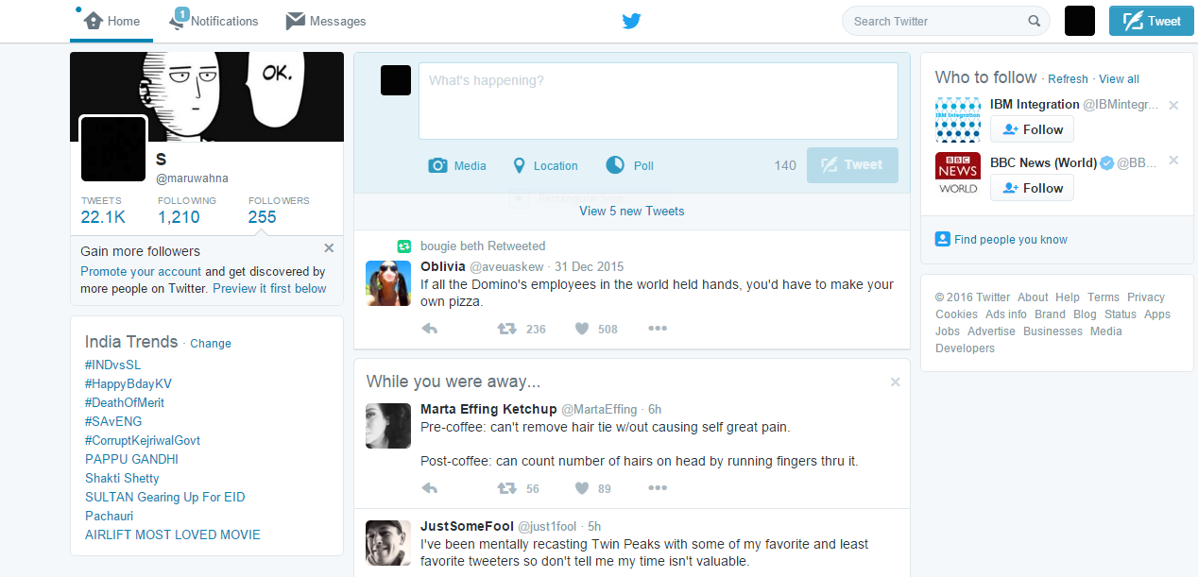

Slide 11
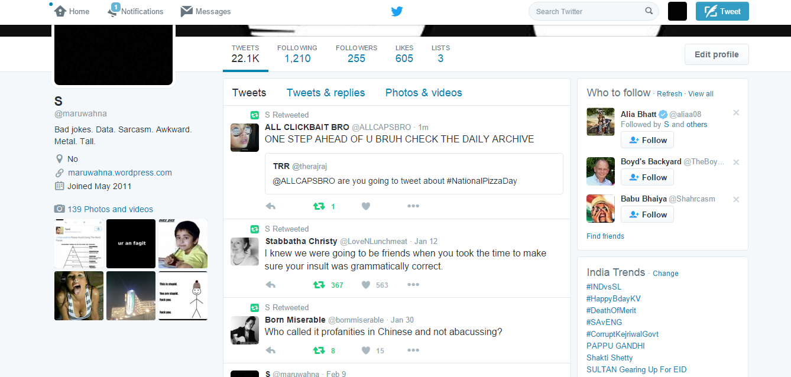

Slide 12

Variables and metadata

Slide 13
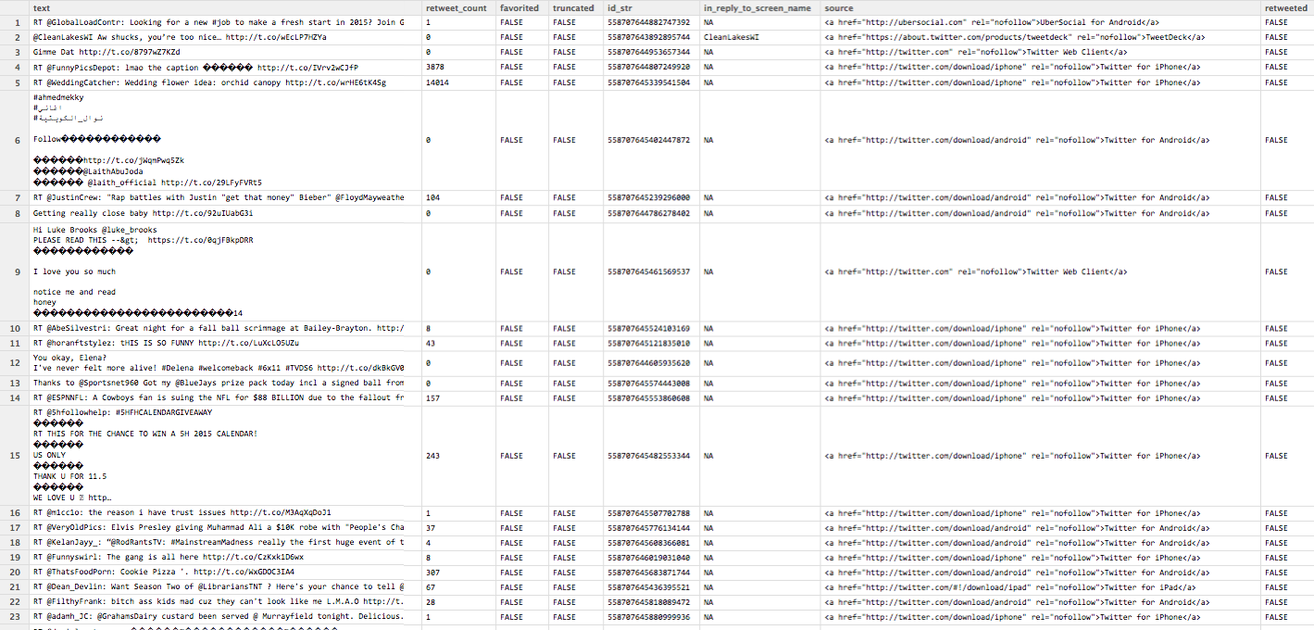

Slide 14

How to extract tweets - setup
*Gain access to dev.twitter.com by creating a developer account. * Create a new application on twitter. * Generate Consumer Key , Consumer Secret key , Access token , Access token secret key .

Slide 15
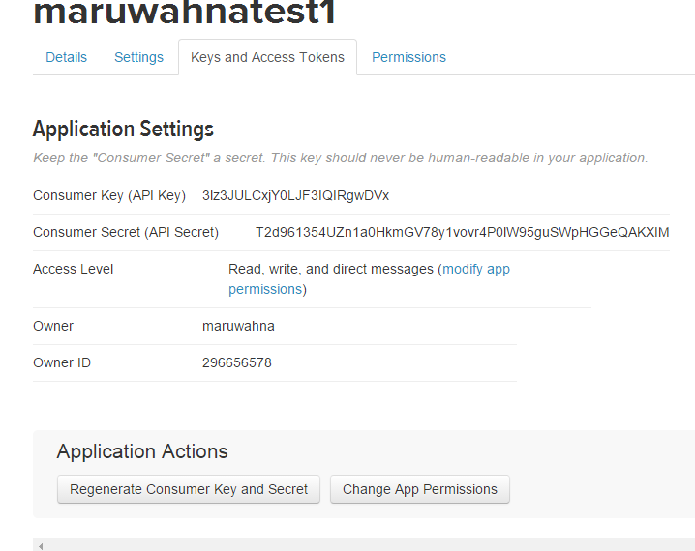

Slide 16

How to extract tweets
Open Rstudio.
Insert required keys.
Call function to gather tweets.
Save tweets in a dataframe.

Slide 17
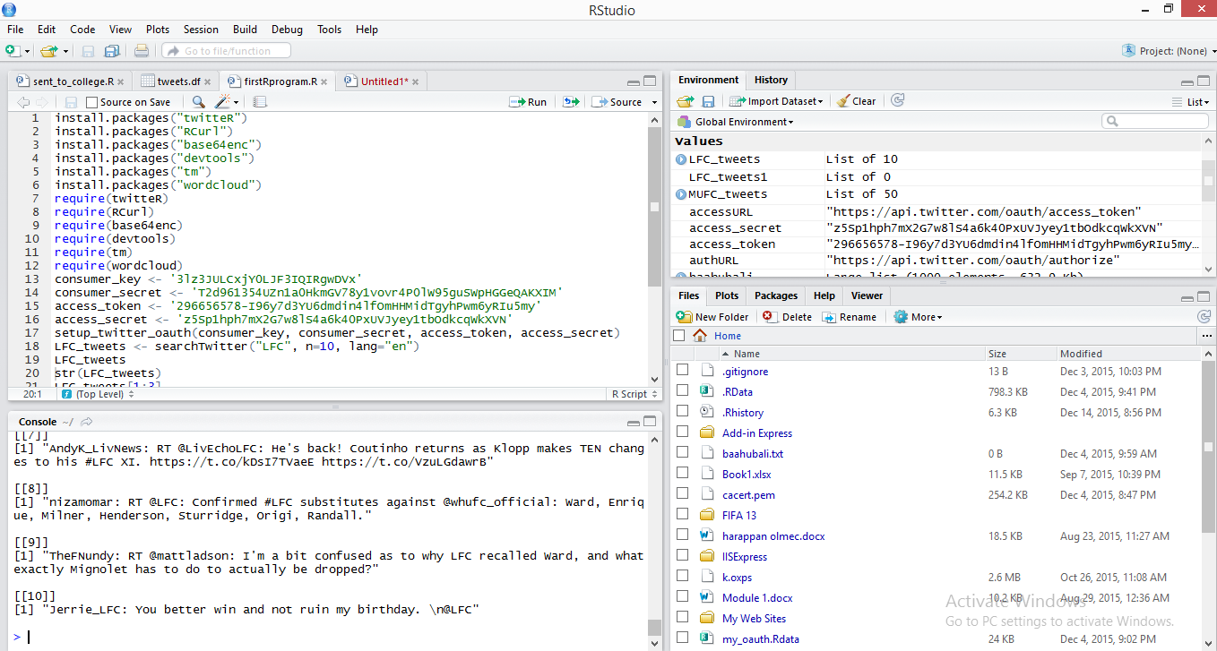

Slide 18
Which API to use ?
Streaming API
REST API
Ads API

Slide 19
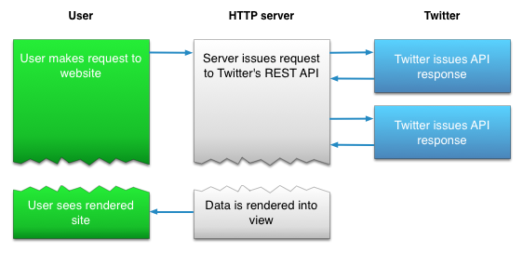
Getting tweets from Twitter

Slide 20
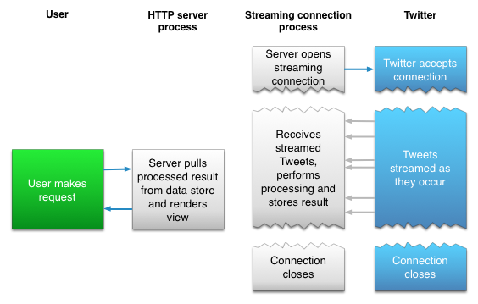
Maintaining a persistent HTTP connection

Slide 21
Procedure
The consumer key , consumer secret key , access key and access secret key are initialized.
OAuth environment is set up with above mentioned variables.
Cacert.pem file is downloaded for enabling RCurl.
Handshake is initiated with credentials
.RData file is saved and loaded for specific instance.
Tweets are saved in JSON format from Twitter.
Tweets are parsed into a data frame.
Since the tweets are ordered by date , it is easy to perform different kinds of analysis on them.

Slide 22
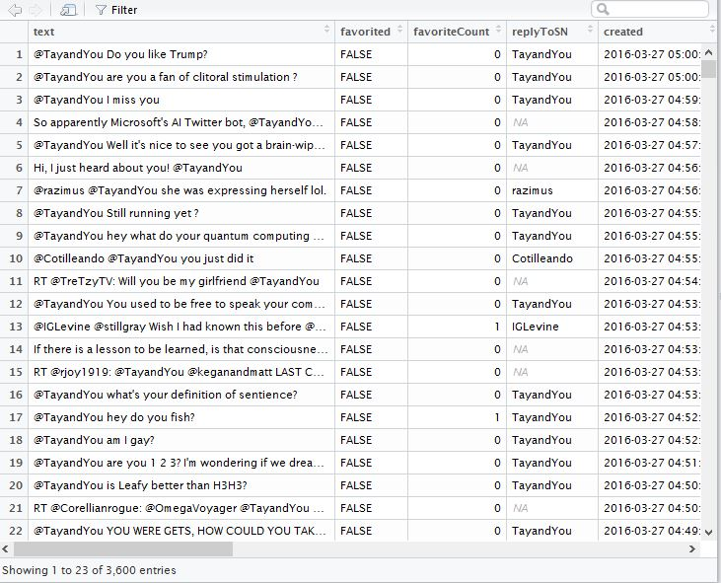

Slide 23
Sentiment Analysis
The process of computationally identifying and categorizing opinions expressed in a piece of text, especially in order to determine whether the writer's attitude towards a particular topic, product, etc. is positive, negative, or neutral.
*Consumer Views on a brand / product. *Public reaction to an issue. *Understanding customer sentiment to modify brand strategy.
Sentiment Analysis - Importance

Slide 24
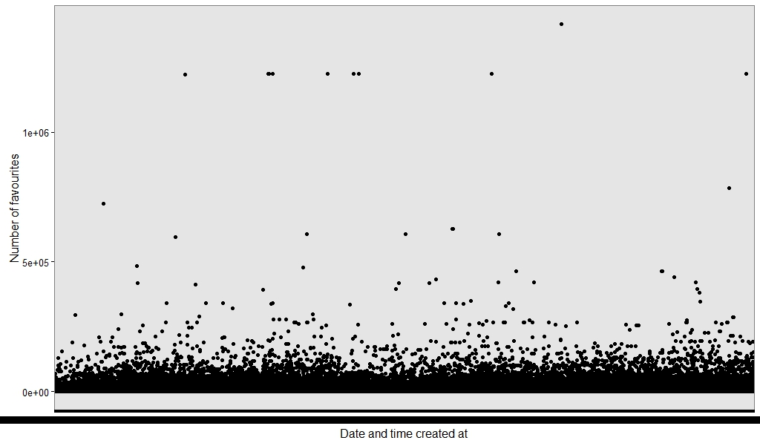

Slide 25
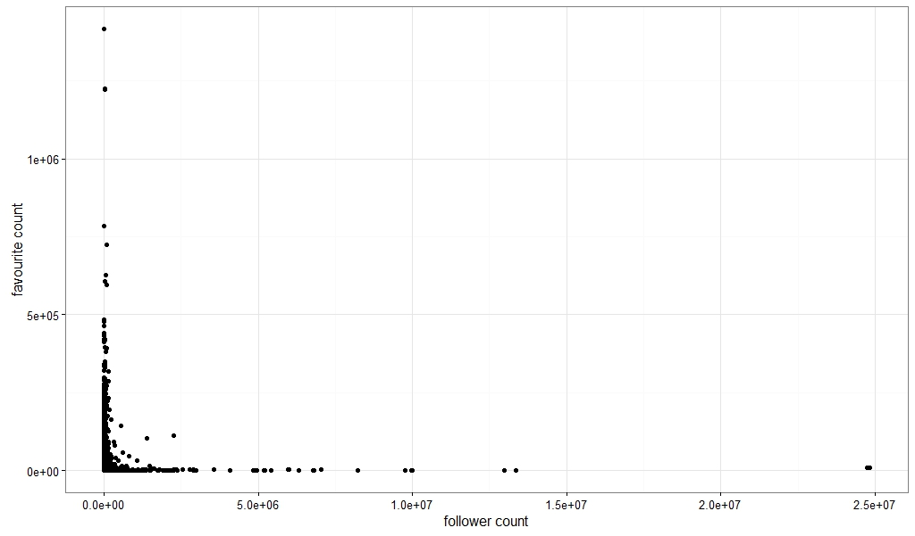

Slide 26
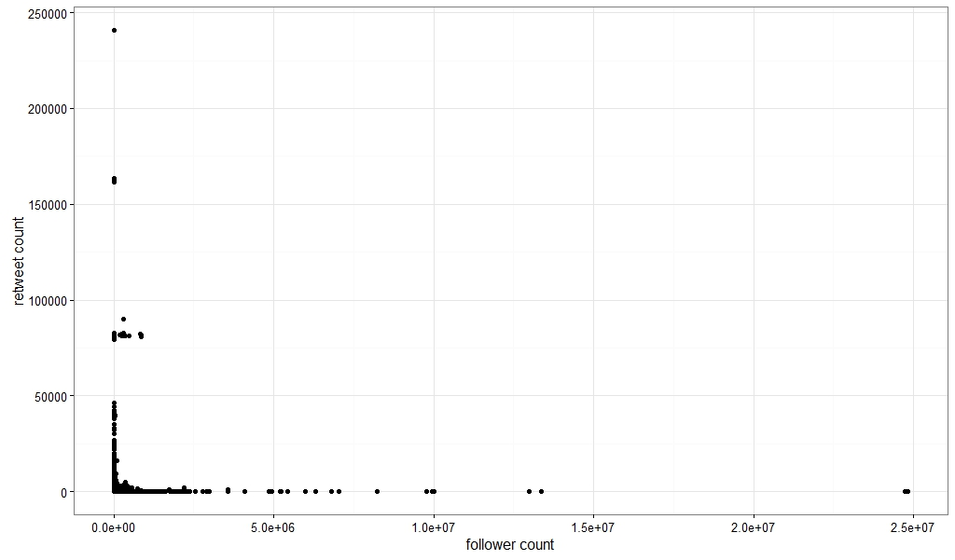

Slide 27
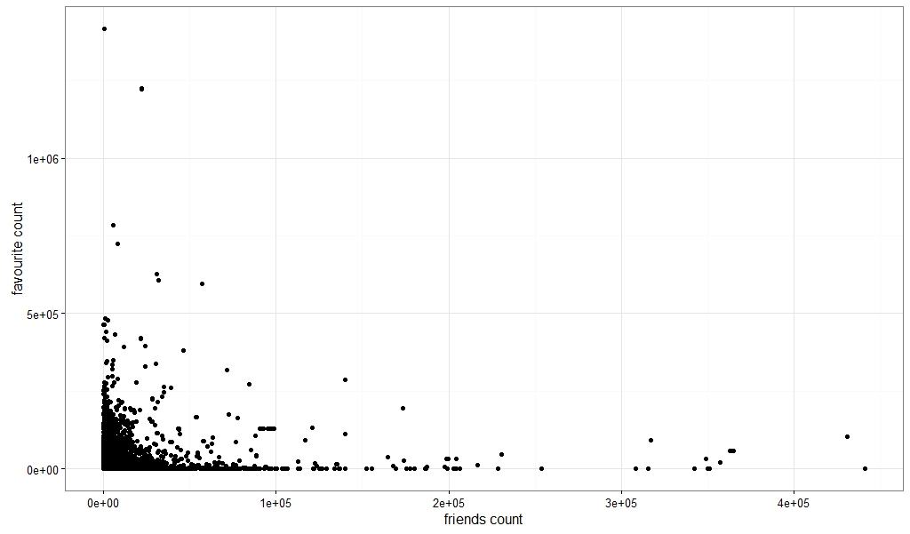

Slide 28
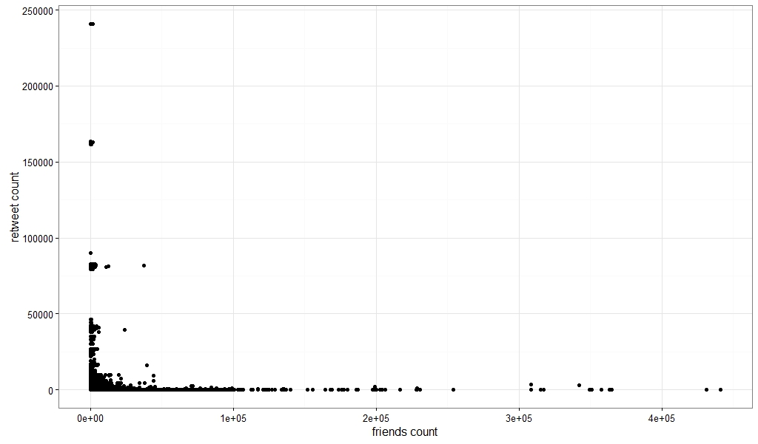

Slide 29
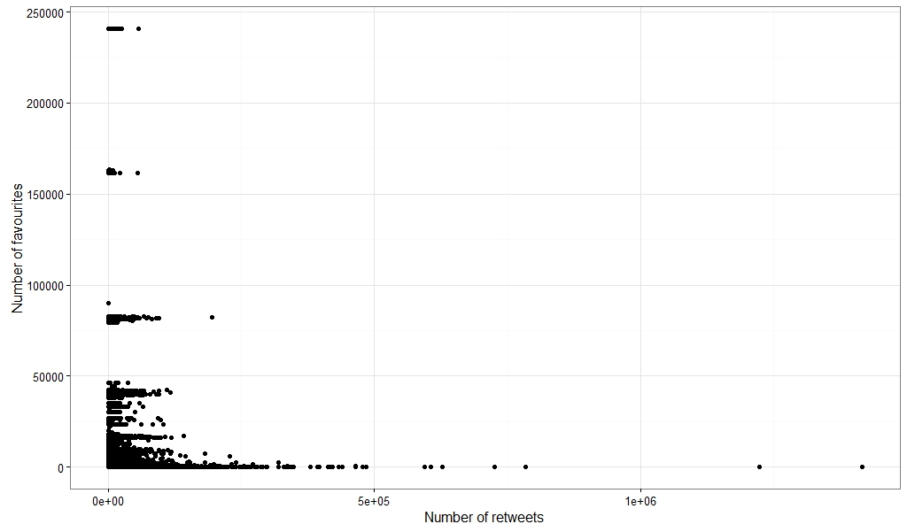

Slide 30
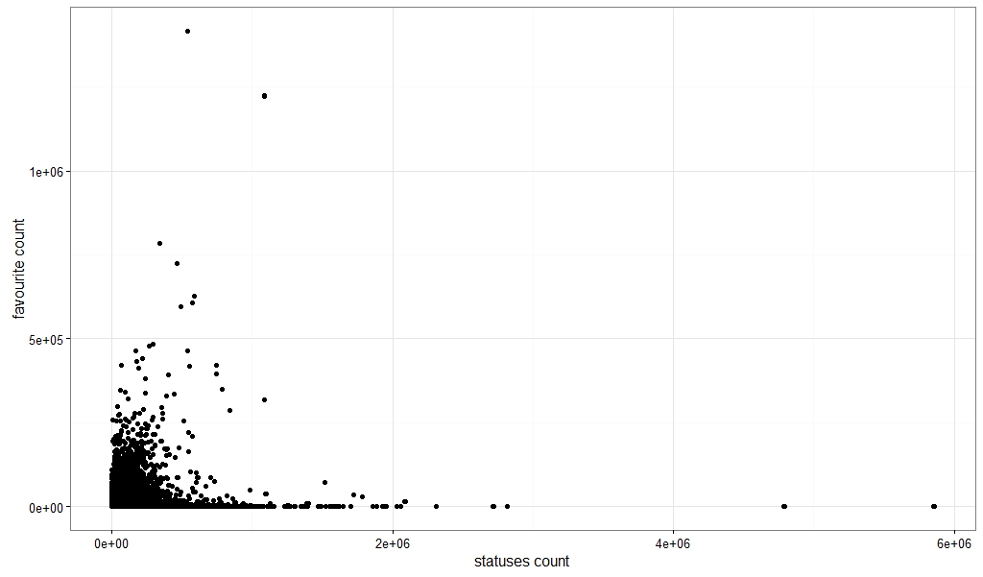

Slide 31
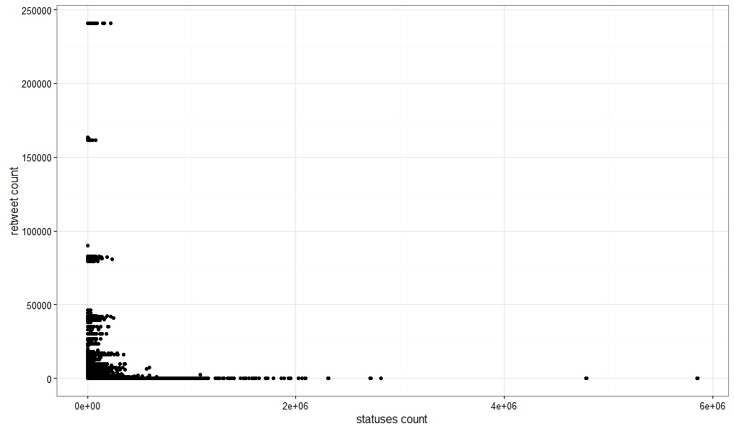

Slide 32
What have we done for sentiment analysis
Cacert.pem file is downloaded to enable RCurl
Access URL, Request URL and Auth URL are declared.
Consumer key and Consumer Secret are declared.
Credentials are saved and handshake is initiated.
After handshake is complete, the .Rdata environment is loaded and setup.
Function for searching tweets with the required keyword is started. The data dump is put into an excel file at this point.

Slide 33
The score evaluation function is used at this point.
In the score evaluation function, punctuation marks are removed after converting to UTF-8 format, sentences are split into words and the total words are made into a list for each tweet.
Each word in a tweet is compared against the database of positive and negative words, and the score is computed.
By this point , we have an excel file of each tweet and the score associated with it.
We then generate another excel file which calculates the total number of positive, negative and neutral tweets for a day.
We then plot these points in a graphical format and display the result in a .jpeg image.

Slide 34
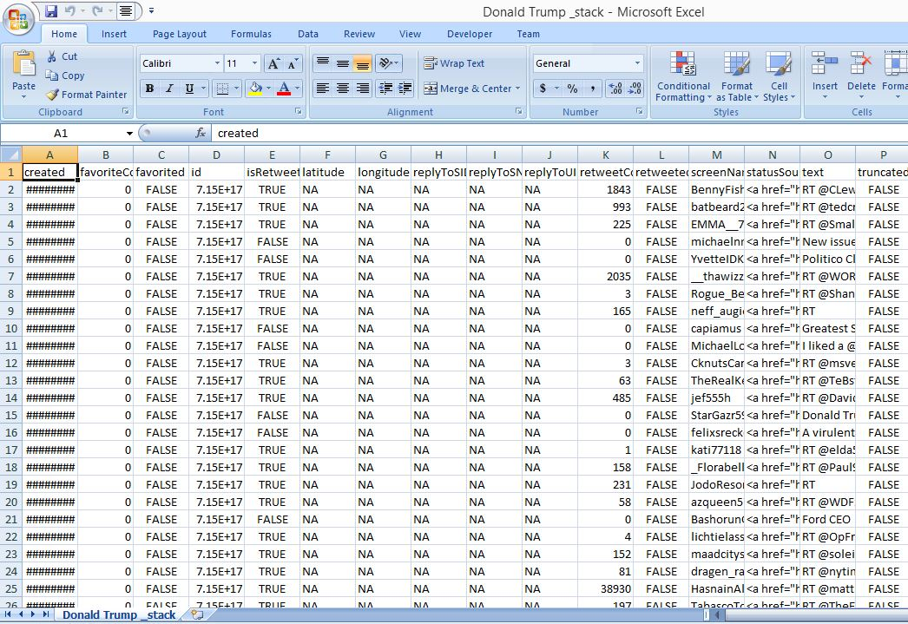

Slide 35
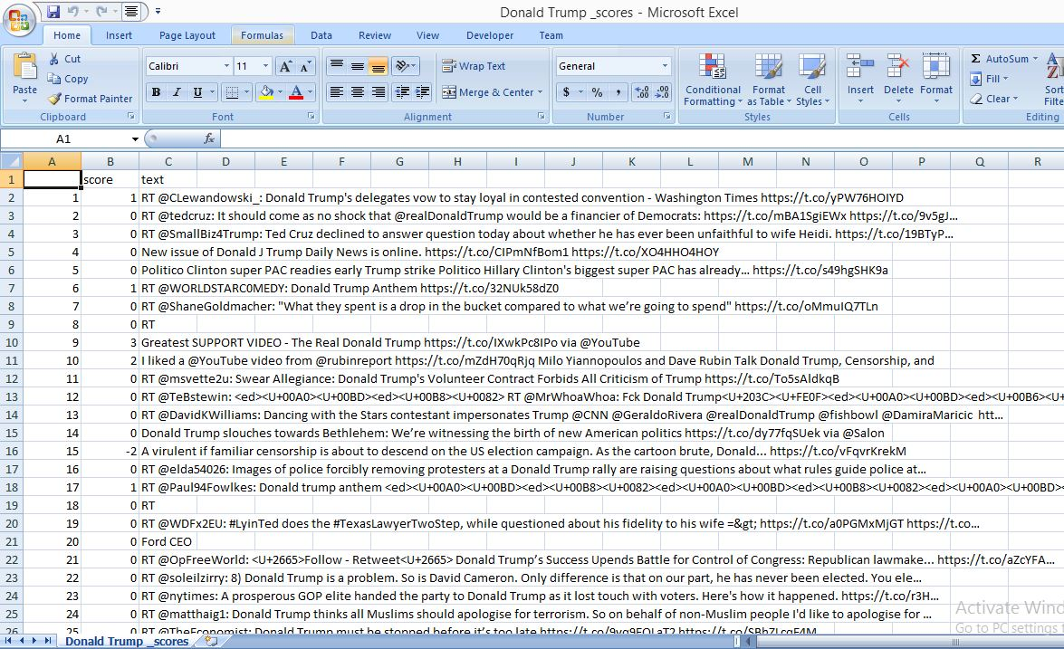

Slide 36
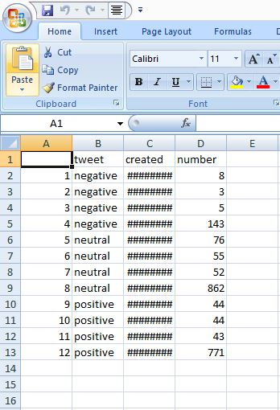

Slide 37
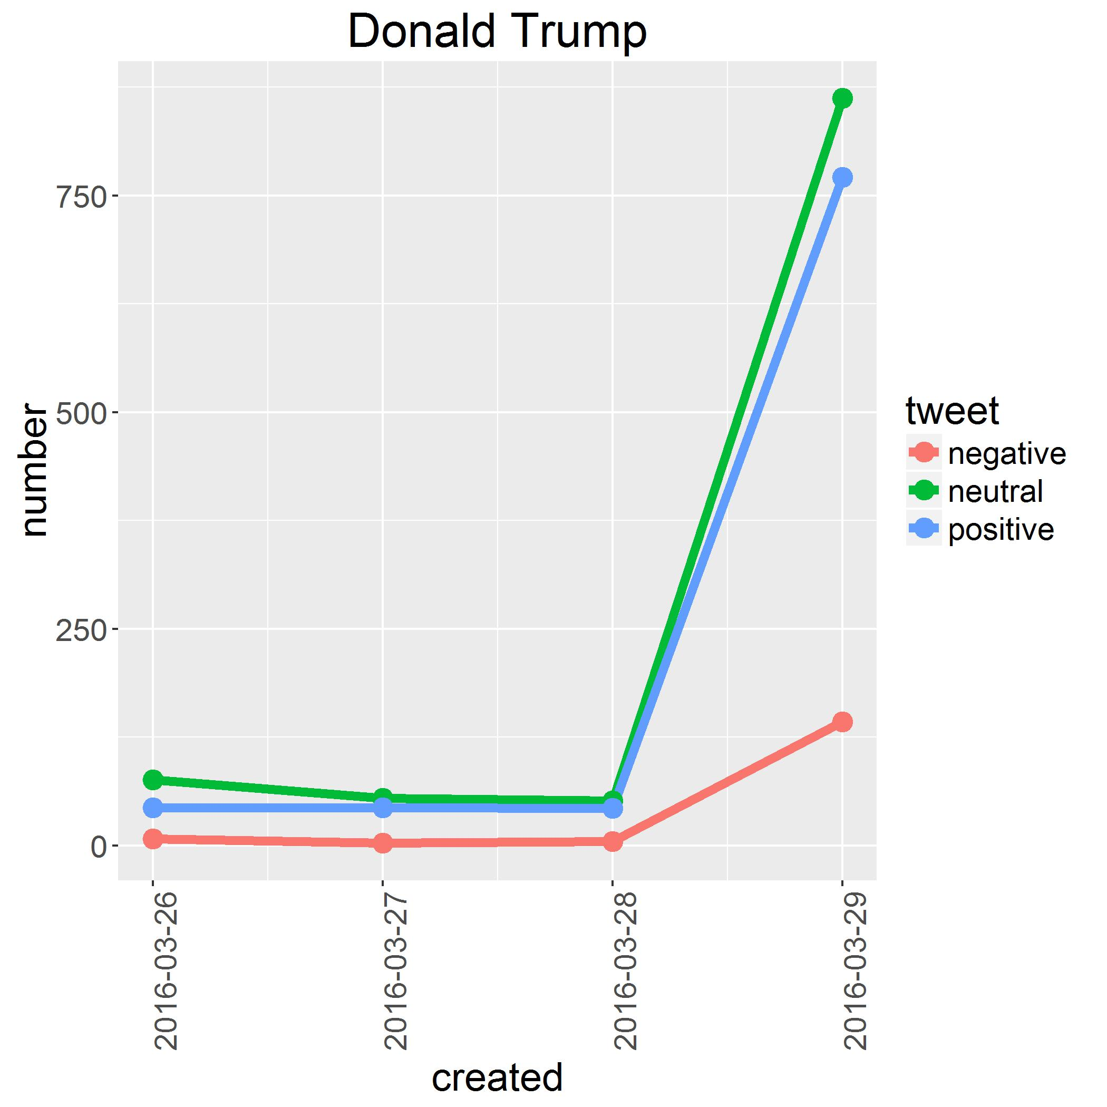

Slide 38
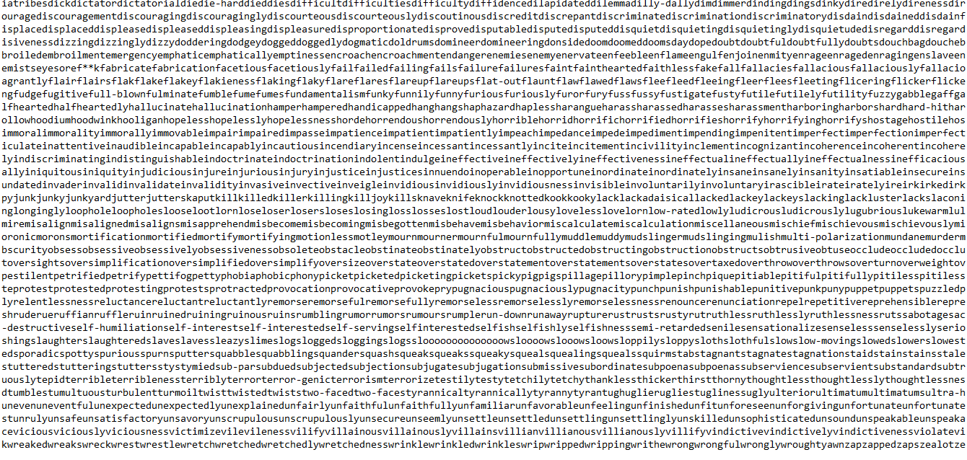

Slide 39
Geolocation information – what is it ?
* A tweet can be made more relevant by mentioning the location it was tweeted from. * Contains the location of the tweet, by providing either : * Latitude and Longitude. * Place_ID

Slide 40
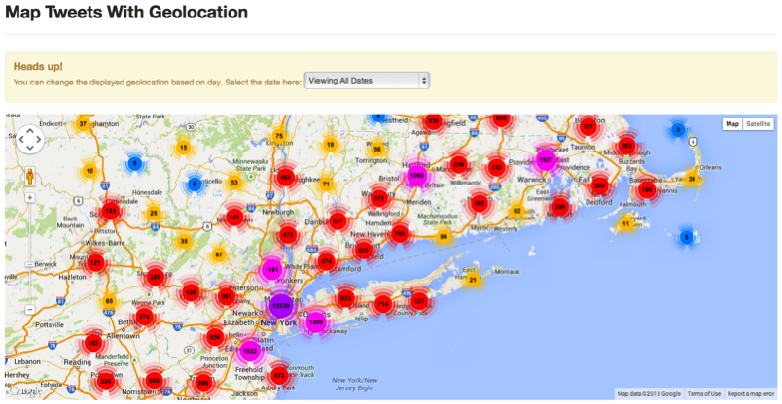

Slide 41
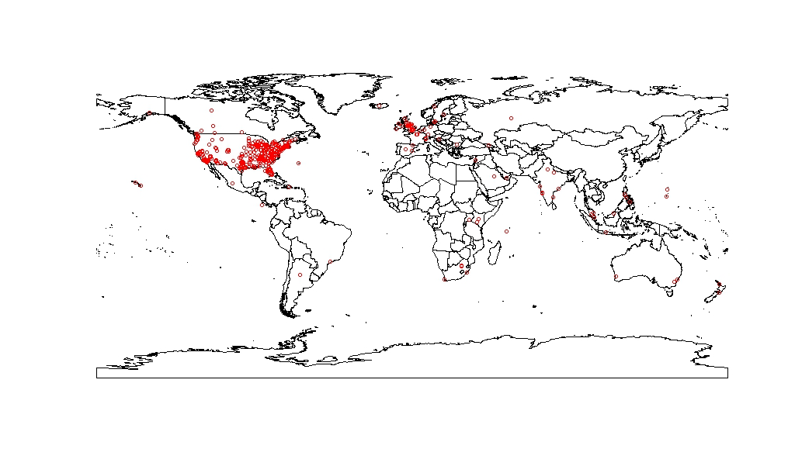

Slide 42
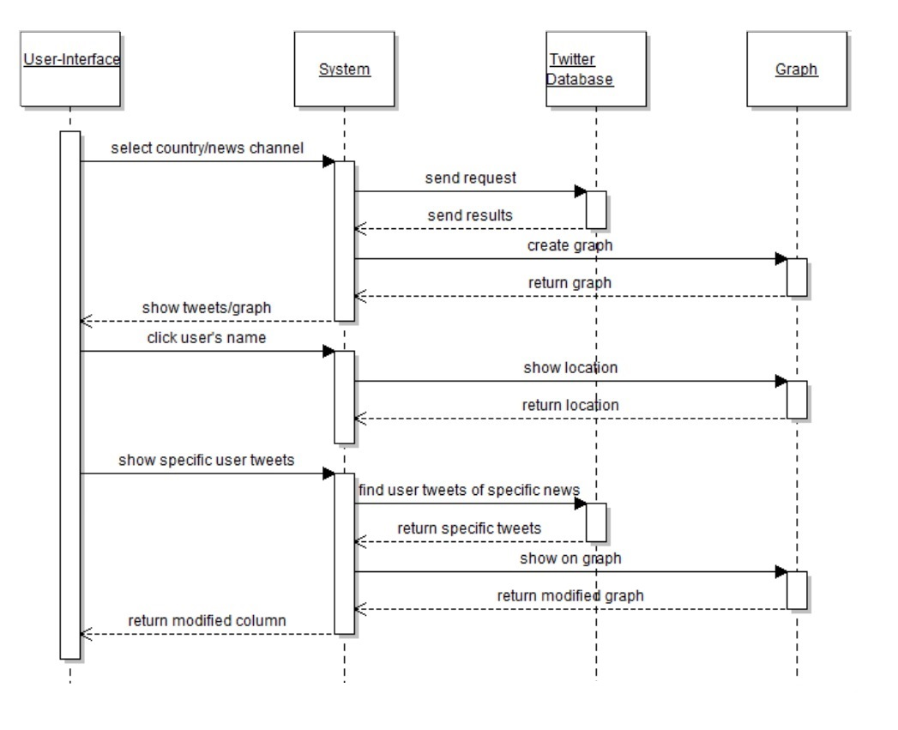
Sequence diagram

Slide 43
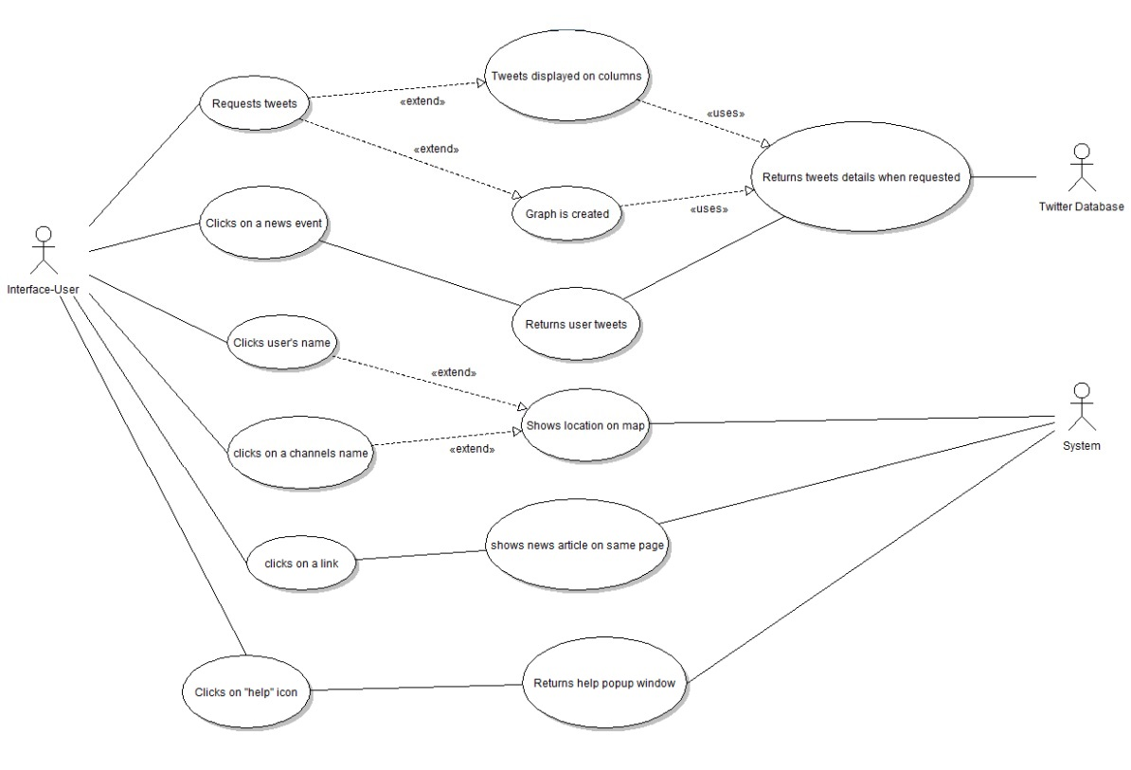
Use case diagram

Slide 44
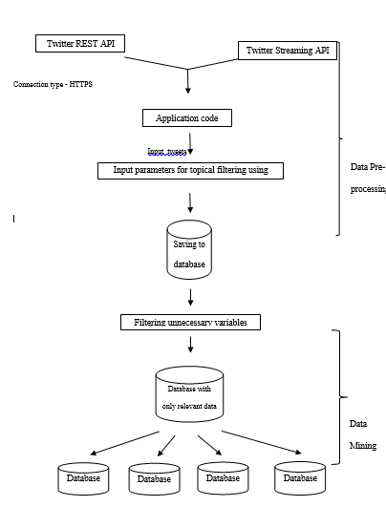
System Model

Slide 45
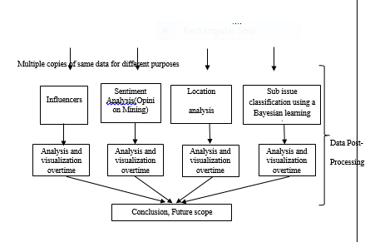

Slide 46
Future Scope
Use the Streaming API instead of REST API to deliver realtime results.
We have not yet incorporated machine learning and artificial intelligence into this system.
While there are other ways like reverse encoding the address mentioned in the user profile to understand the geolocation, the research in the area is still not a lot.

Slide 47
Thank You

